Slide 1

Data Driven Education
Discussion Forum Subteam
Presentation 1 - 9/29/2021
Notes:
Pratik

Slide 2

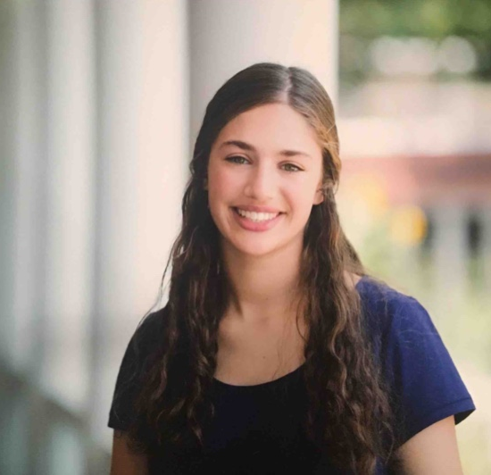
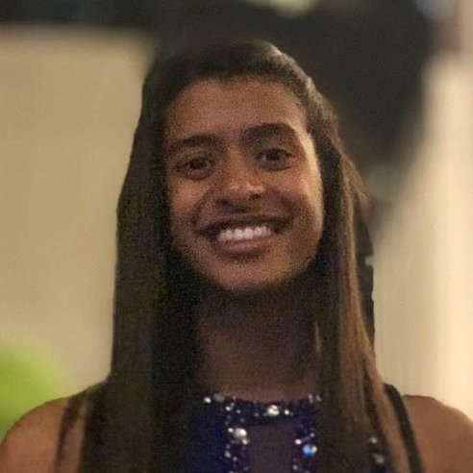

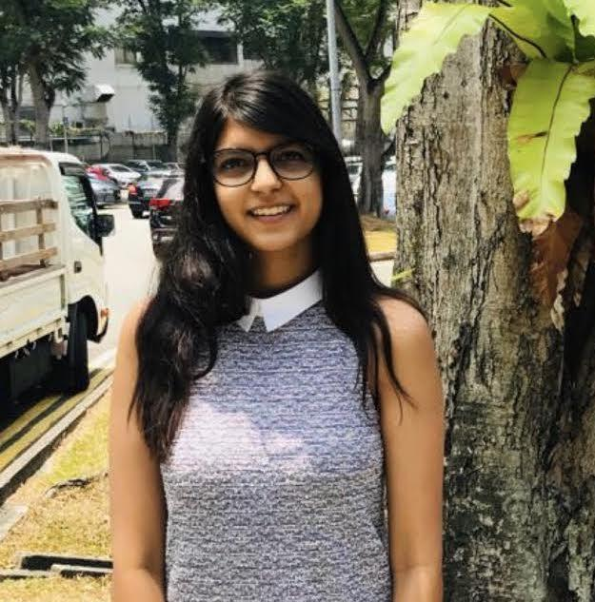
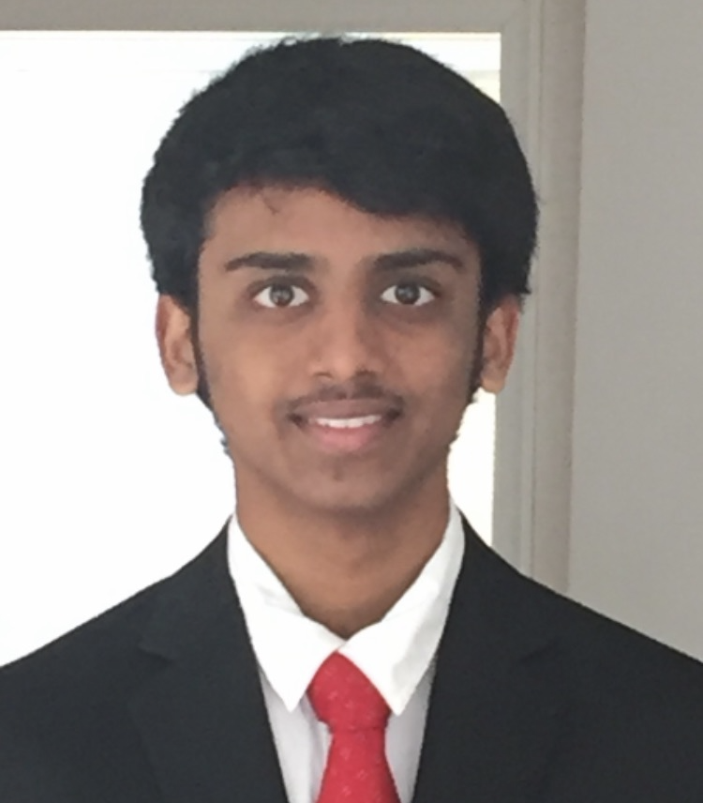
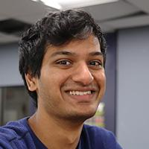
Team Members
Malav Patel
Data Scientist
Sarah Kaufman
Data Scientist
Nidhi Pai
Data Scientist
Pratik Agarwal
Project Manager
Aanya Khandelwal
Back-end
Developer
Gautam Sugasi
Back-end
Developer
Sambhav Jaideep
Front-end
Web Developer
Notes:
All

Slide 3


Introduction
Discussion forums
  Online formats - primary source of interaction
Student interaction
  Cognitive presence
  Social presence
Activity on forums indicative of student engagement and interest
Goal: Creating a web application to be used by professors to make their courses more effective and engaging
Notes:
Discussion forums are the primary source of class interaction in an online asynchronous course. The activity on these forums can be used as an indicator for assessing students’ engagement and understanding in the course. A popular framework in this context is the community of inquiry framework. It gives us a way to study how student learning takes place in online and blended environments. As shown in the diagram there are 3 components, cognitive presence, social presence and teaching presence.We’re focusing on the first two as of now. The ultimate long term goal is to have a web-based application to be used by professors, that gives them insights in real-time which can be used to improve the student experience and engagement in their courses.

Slide 4
Recap of Spring 2021
Data Science
  Model for automated classification of cognitive presence
  Exploratory social network analysis highlighting the concentration of activity in forums around certain users
UX research
  Interviews/surveys with instructors
  Identification of metrics of interest, and some preliminary visualizations for these metrics
Web-dev
  Working demo of the web-app based on dummy data
Notes:
In the previous semester, we were able to get a working demo of the web-app on dummy data. In addition, we conducted interviews/surveys with multiple instructors to identify the metrics of interest that they’d like to track for their courses. The data science team parallely focused on building a machine learning model to automatically classify threads/comments and started exploring the social component of these interactions. The details will be listed by the respective teams.

Slide 5

Key Takeaways for project overall
Inter-team communication and project alignment - Slack
Agile Sprint - Trello boards
•Current progress is reflected
•Backlog provides insight for future subteams
Minutes were helpful
•Notebooks
•Review
•Future team
Should have conducted interviews early on
This semester: Design document, Test-driven development, good documentation practices, and explore the possibility of a CI/CD pipeline
Notes:
Talking of overall learnings, we realized the importance of conducting interviews with end-users early-on, which helps keep the project focused. In addition, the use of Trello for tracking sprints and individual progress, communication using slack, and the importance of documentation (meetings, notebooks, code etc.) was also acknowledged. For this semester, the goal is to go one step further by adopting industry best-practices of documentation, test-driven development and maintaining a well-structured design document. The possibility of a Continuous Integration and Deployment pipeline for the web-app will also be explored. Now, I’ll let the teams walk through the details, starting with the data science team.

Slide 6
Data Science

Slide 7
Research Goal
Identify key factors influencing student engagement and performance in an asynchronous online classroom using the community of inquiry framework, and provide actionable insights to the instructors through the web app.
Notes:
Nidhi

Slide 8
Data Science Big Picture
Data available
  Focusing on Piazza data from Dr. Thad Starner
  1493 posts, coded for cognitive presence
  Include student outcomes: final grades
Cognitive Presence
Sentiment Analysis
Data Science
Student Outcomes
Social Presence
Notes:
Nidhi

Slide 9
Cognitive Presence (Garrison et al., 2001)
0: No Cognitive Presence
1: Triggering Event
2: Exploration
3: Integration
4: Resolution
Logistics
Socializing
“Thank you”
Unclear comments (code without comment)
Short questions
Technical clarification
“I am clueless”
“I think this is right/wrong”
Focus on the problem itself
Describing a problem
Giving suggestions
Partial understanding
Clarifications with detailed description or own assumptions
Proposing a solution
Giving their solution
Giving a textbook or other reference
Partial solutions
Confirmation of ideas
Elaboration on solution
Explain why/how solution works in detail
Definite comments
Comments from instructors
Direct answer

Slide 10
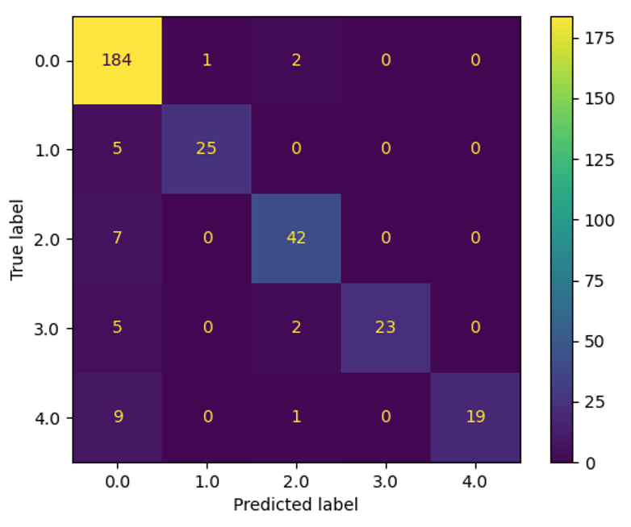
Cognitive Presence Modeling with BERT Language Model
Work with the model to predict cognitive presence in Piazza comments
Last semester: >80% f1-score was achieved on the Training set with BERT Fine-tuning Language Model
Challenges encountered: Mis-classification in test set frequent among adjacent labels, needed to consider different metrics
Goals for this semester:
  More data, cleaner extraction from Piazza (removing code segments etc)
  Using the BERT (Devlin J. et al, 2018) model to generate output with the Piazza data
  Improve the accuracy of the existing model (w/o using different metric) or develop a new model (if time permits)

Slide 11
Sentiment Analysis
Rate posts by positive, negative, or neutral sentiment
Last semester: Conducted sentiment analysis with pre-existing VADER model in Python Natural Language Toolkit (nltk) package
Challenges encountered: Pre-existing models used, limited data available
Goals for mid-semester:
  Search for a better model to perform the analysis
  Perform Sentiment Analysis on actual Piazza data (comments) pre-existing/new model
  Provide results to the Web Development team

Slide 12
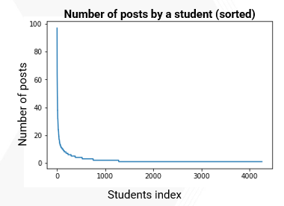
Social Presence
Last semester:
  Created a graph representation of the interactions between students
  Found that the majority of posts were created by a small number of users
Challenges encountered:
  Sampling bias. Lack of data on students who passively browse the forums
Notes:
Sarah
social presence desks more with looking at students as individuals

Slide 13
Goals for this semester (Social Presence)
Analyzing the topics where the student participation is concentrated, and the sentiment around those topics
Identifying the variation in the style of communication between students from the lens of CoI framework
Studying the relationship between discussion forum activity and performance in the course
Notes:
sarah

Slide 14
Student Outcomes
Goal: Model student final grades as a function of discussion forum participation
Features that predict final grades are likely also useful for professors to see on dashboard
Goals for this semester:
  Correlation analyses to identify important features
  Predictive model
Number of answers
Cognitive presence
Final grades
Number of posts
Timing of posts
Notes:
Sarah

Slide 15
UX Research

Slide 16
User Surveys & Interviews
Goal: Understand what metrics instructors need on the dashboard
Disconnect between what researchers and professors want to know about discussion forums
Last semester:
  Conducted a pilot survey of TA’s and instructors to understand what metrics from Piazza are useful to them
  Showed instructors some ideas for metrics and asked them to rate usefulness
  Interviewed Dr. David Joyner: discussed design of online forums
Notes:
Nidhi
Joyner - talked about threading issues regarding structure of interface, and sampling bias becasue few students actually participate

Slide 17
User Surveys & Interviews - Previous Work
Survey composition:
26 responses, mostly CS TA’s
Use cases of metrics from Piazza:
Identifying students who contribute often with good posts
Identifying struggling students
Finding common topics that students are struggling with
Gauge of class activity & morale
Increasing instructor presence and distributing workload across TAs
Notes:
Nidhi

Slide 18
User Surveys & Interviews - Challenges & Goals
Challenges encountered:
  Ill-defined metrics, metrics created off intuition
  Small sample size
Goals for this semester:
  Refine what metrics we ask about
  Expand the sample size for survey, especially in different departments
  Interview some TAs and more instructors
Notes:
Gautam

Slide 19
Web Development

Slide 20
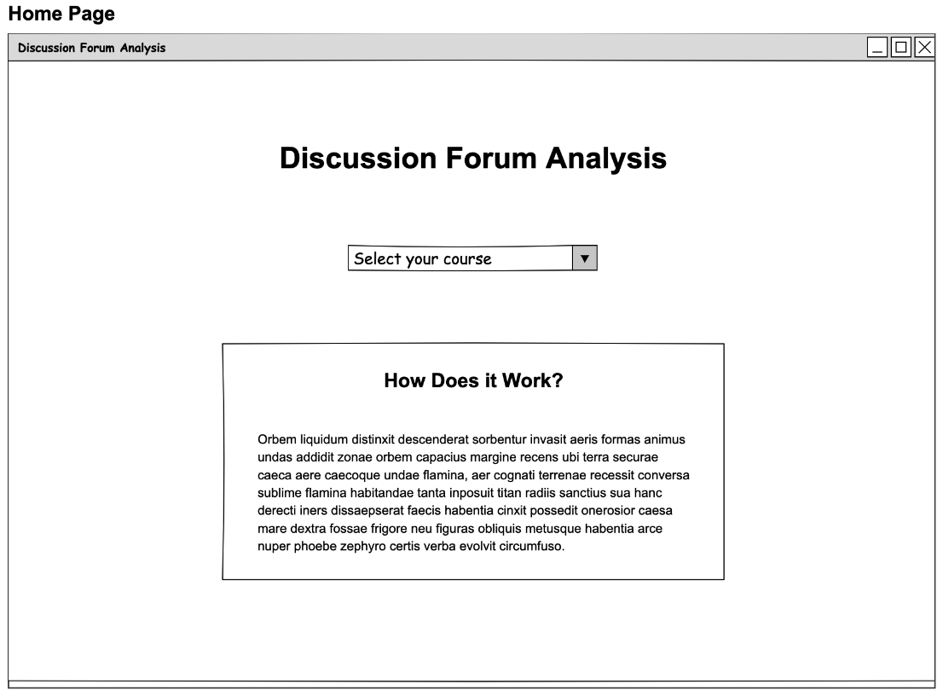
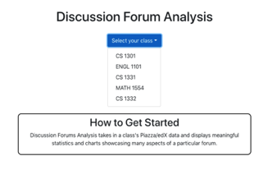
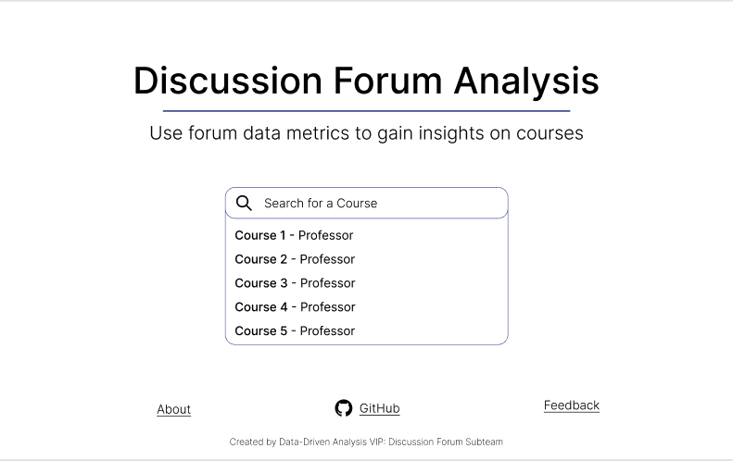
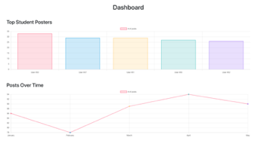
Front-End Web Development
Created high-fidelity mockups using Figma (design software)
  Based off of low-fidelity wireframes of last semester
Will continue translating design into code, iterating using feedback
  Using React.js, HTML, CSS, JavaScript
Spring 2021 Demo
Wireframe
Figma Mockup
Notes:
Sambhav

Slide 21
Back-End Web Development
Created a dummy pipeline in previous semesters
  Pipeline integrates React with the backend database
  Using Flask, SQLite, and SQLAlchemy
Start with extracting metrics used by data science team and sending it to the front-end
  sentiment and polarity
Transitioning into research phase to learn more about the metrics we need
  Surveys, interviews with TAs, meetings with professors, etc.
Notes:
Aanya

Slide 22
Workflow Diagram
Raw Data in Database
Integration with Back-End
Last semester
End goal for this semester
Analysis from Data Science Team
Presentation via Front-End
Here right now
End goal for this semester/continue working next semester
Notes:
Gautam

Slide 23
Conclusion
Project Roadmap
  Interviews/surveys
  Design document
Data science
  Integrating the classification pipeline with the web-app
  Continue exploring social presence, and improve cognitive presence model
Web development
  Building out Front-End
  Working alongside data science team to do more research on the required data, metrics relevant to the instructors
Notes:
To conclude, the next steps in the roadmap are conducting more interviews/survey which will be used to improve the user-interface by the web-app team, getting the design document ready and integration of the classification pipeline with the web-app. In addition, we’ll also continue exploring social presence and tuning our cognitive presence model to get better performance. Thank you for your time.

Slide 24
Citations
Garrison, D. R., Anderson, T., & Archer, W. (1999). Critical Inquiry in a Text-Based Environment: Computer Conferencing in Higher Education. The Internet and Higher Education, 2(2–3), 87–105. https://doi.org/10.1016/S1096-7516(00)00016-6
Garrison, D. R., Anderson, T., & Archer, W. (2001). Critical thinking, cognitive presence, and computer conferencing in distance education. American Journal of Distance Education, 15(1), 7–23. https://doi.org/10.1080/08923640109527071
Devlin, J., Chang, M. W., Lee, K., & Toutanova, K. (2018). Bert: Pre-training of deep bidirectional transformers for language understanding. arXiv preprint arXiv:1810.04805.
Medhat, Walaa, Hassan, Ahmed, Hoda, Korashy (2014). Sentiment analysis algorithms and applications: A survey. Ain Sham Engineering Journals. https://doi.org/10.1016/j.asej.2014.04.011

Slide 25
Questions?

Slide 26
Data Science Goals
First, focus on
Timeframe
Notes:
Malav

Slide 27
Approach used in previous semester
The classic WMD example from [5]

Slide 28
Challenges encountered

Slide 29
Goals for this semester (Data Science)
Sentiment Analysis of Piazza Data

Slide 30

Community of Inquiry
“a group of individuals who collaboratively engage in purposeful critical discourse and reflection to construct personal meaning and confirm mutual understanding”
Elements of an Educational Experience (Garrison et al., 1999)

